Slide 1
Illahee Tire Reef
Cleanup (Phase 2)
10 January 2024
PORT OF ILLAHEE
Safer, Smarter, Better | Reimagining Government Together

Slide 2
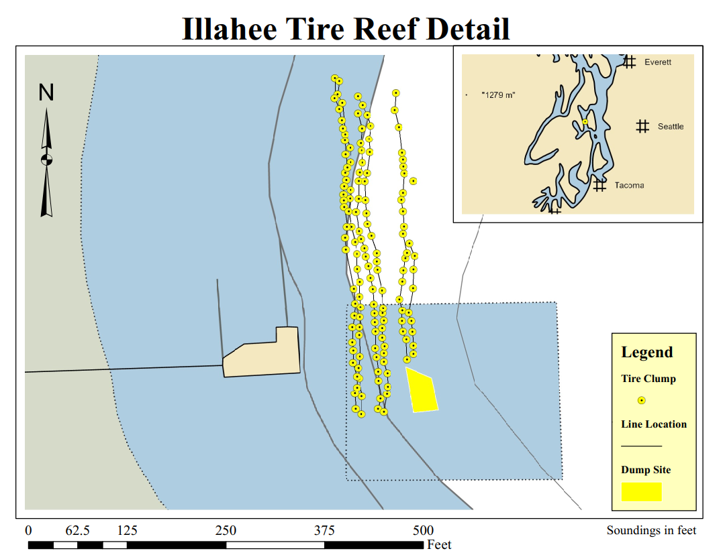
History
Port of Illahee has been mandated to remove tire reef structure by November 2028 as a condition of their DNR Lease.
25 October 2023- Serco conducted detailed Sonar Survey and ROV (visual) inspection of tire reef structure near Illahee pier.
138 clumps located
Clumps secured by yellow poly line
12-20 tires per clump
60,000-100,000 lbs of tires for removal

Slide 3
Project Goals
Conduct a test removal of 1-3 tire clumps (324-1620lbs)
Assess the impact of removal to water quality (turbidity)
Evaluate removal best practices
Determine overall removal project timeline and cost
Meeting Goals
Establish the Statutory and Regulatory requirements for completion of this project
Determine Stakeholder Roles & Responsibilities
Define Realistic project timeline and milestones

Slide 4
Removal
Methodology
Divers from Kitsap Underwater Search and Rescue Volunteer will secure an individual clump using hard rigging (chain) and disconnect the clump from the neighboring reef structure
Floatation will be attached to the chain and inflated to break bottom suction
Tire clump will be brought to the surface and tied off to cleats at the Illahee pier
Lines will be used to pull the clump to the boat launch area at the pier
Rigging and inflation will be removed and tires will be transported to an on site dumpster for removal
Time Frame 8 hrs
Roles and Responsibilities
On site supervision – Serco
Diver Support – USRV Kitsap
Disposal – Serco
Pier access – Port of Illahee
Labor – Port of Illahee

Slide 5
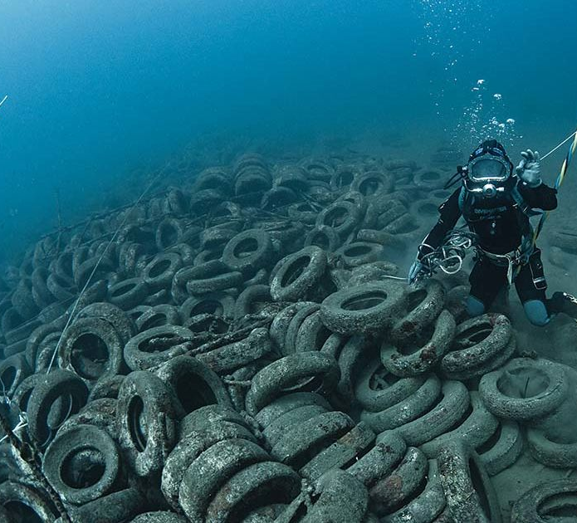
Removal
Logistics
USRV Kitsap has all appropriate lifting and rigging gear
Disposal will be coordinated through Kitsap public works
Assistance from Port volunteers to move tires from waterline to dumpster is needed
Media presence is at the discretion of the onsite supervisor (SAFETY)

Slide 6
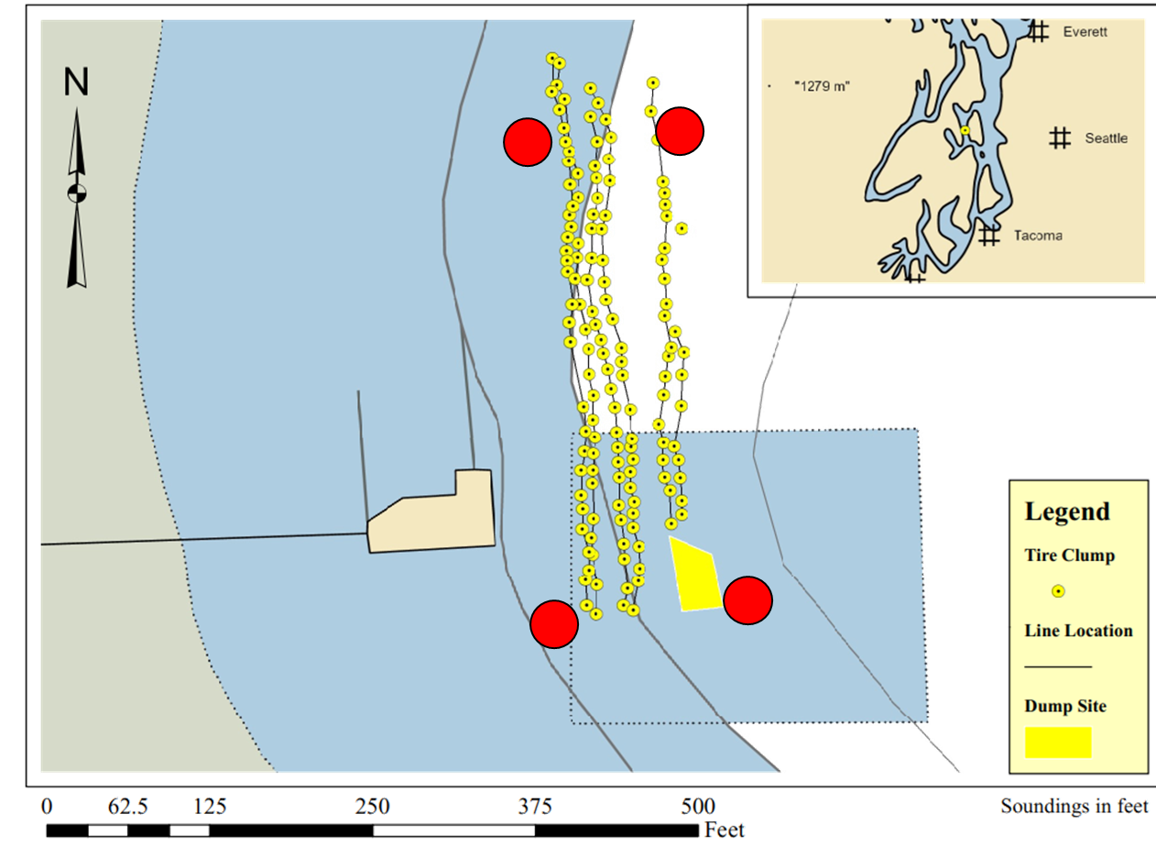
Water Quality Monitoring
Insitu turbidity monitoring to be installed by SERCO prior to removal operations and left in place to monitor through two tidal exchanges.
This will allow us to show the rate of dissipation that can be expected following a removal from this site.
Four monitoring buoys are proposed
Each bouy will be configured with turbidity sensors at 1 ft, 10ft and 20ft below the water line to capture turbidity at depth.

Slide 7
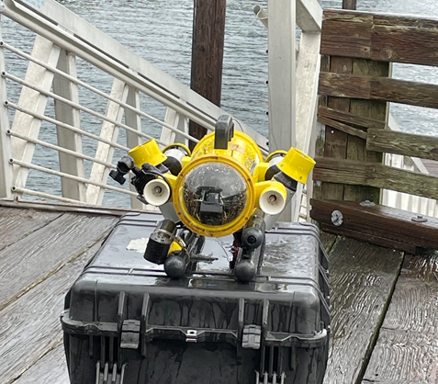
Post Monitoring
2-4 weeks following removal side imaging sonar survey and ROV inspection will be completed to assess the impact of removal activities.

Slide 8
Regulatory Stake holders
Washington Department of Fish Wildlife
Washington Department of Natural Resources
Washington Department of Ecology
Kitsap County Department of Community Development
Army Corps of Engineers

Slide 9
Non Regulatory Stake Holders
Washington Autonomous Vehicle Cluster (WAV-C)
Port of Illahee
Suquamish Tribe
PORT OF ILLAHEE

Slide 10
Permitting & notifications
Hydraulic Project Approval (WDFW)
Section 401 Water Quality Certification (Ecology)
Shoreline Substantial Development Permit (Kitsap County)
Army Corps Nation-wide permit 27 (Army Corps)
Notice to Mariners (US Coast guard)
Property owner notifications (Port of Illahee)
Local Media Outlets (WAV-C)

Slide 11
Project Time Line
Removal slated for Summer 2024 to minimize impacts to forage fish spawning windows.
Jan 2024
Feb 2024
Mar 2024
Apr 2024
May 2024
Jun 2024
Jul 2024
Aug 2024
Budgeting
-SERCO to weigh Requirements, Consumables, and Labor to accomplish removal.
-Quote to be provided through WAV-C
Pre-Removal Activities
-Public Outreach
-Turbidity baseline measurements
Post-Removal Activities
-Site Survey
-ROV Inspection
-Final Report
-Cost analysis for full removal
Initial Stakeholder meeting
-Establish Program Requirements
-Identify Knowledge Gaps
Go/ No Go
-Permit Applications to meet removal timeline
Removal

Slide 12
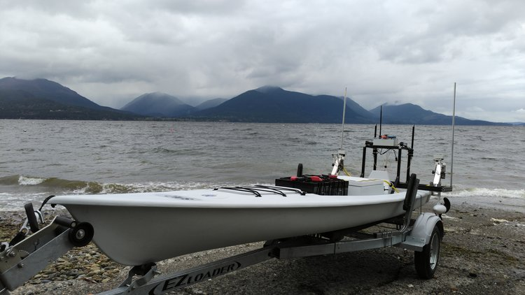
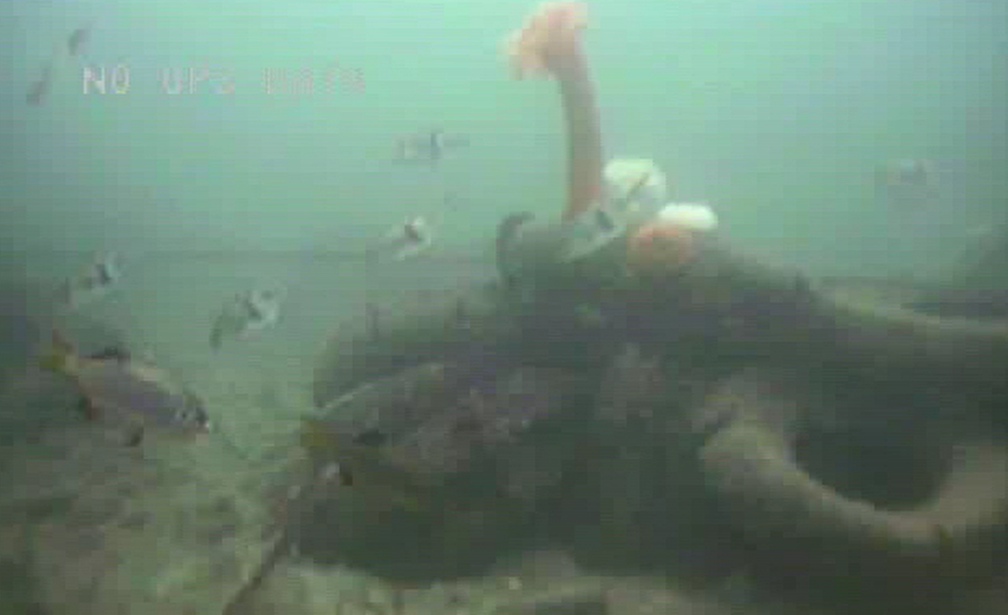
Questions

